Slide 1
Erasmus+ AgroFuture 1
br. projekta 2022-1-HR01-KA121-VET-000066979 u sklopu VET akreditacije
Limassol, Cyprus
23.04.2023-06.05.2023

Slide 2
Irrigation requirements for VET Centre Kleos
By: Natalija Fruk and Martin Vuković

Slide 3
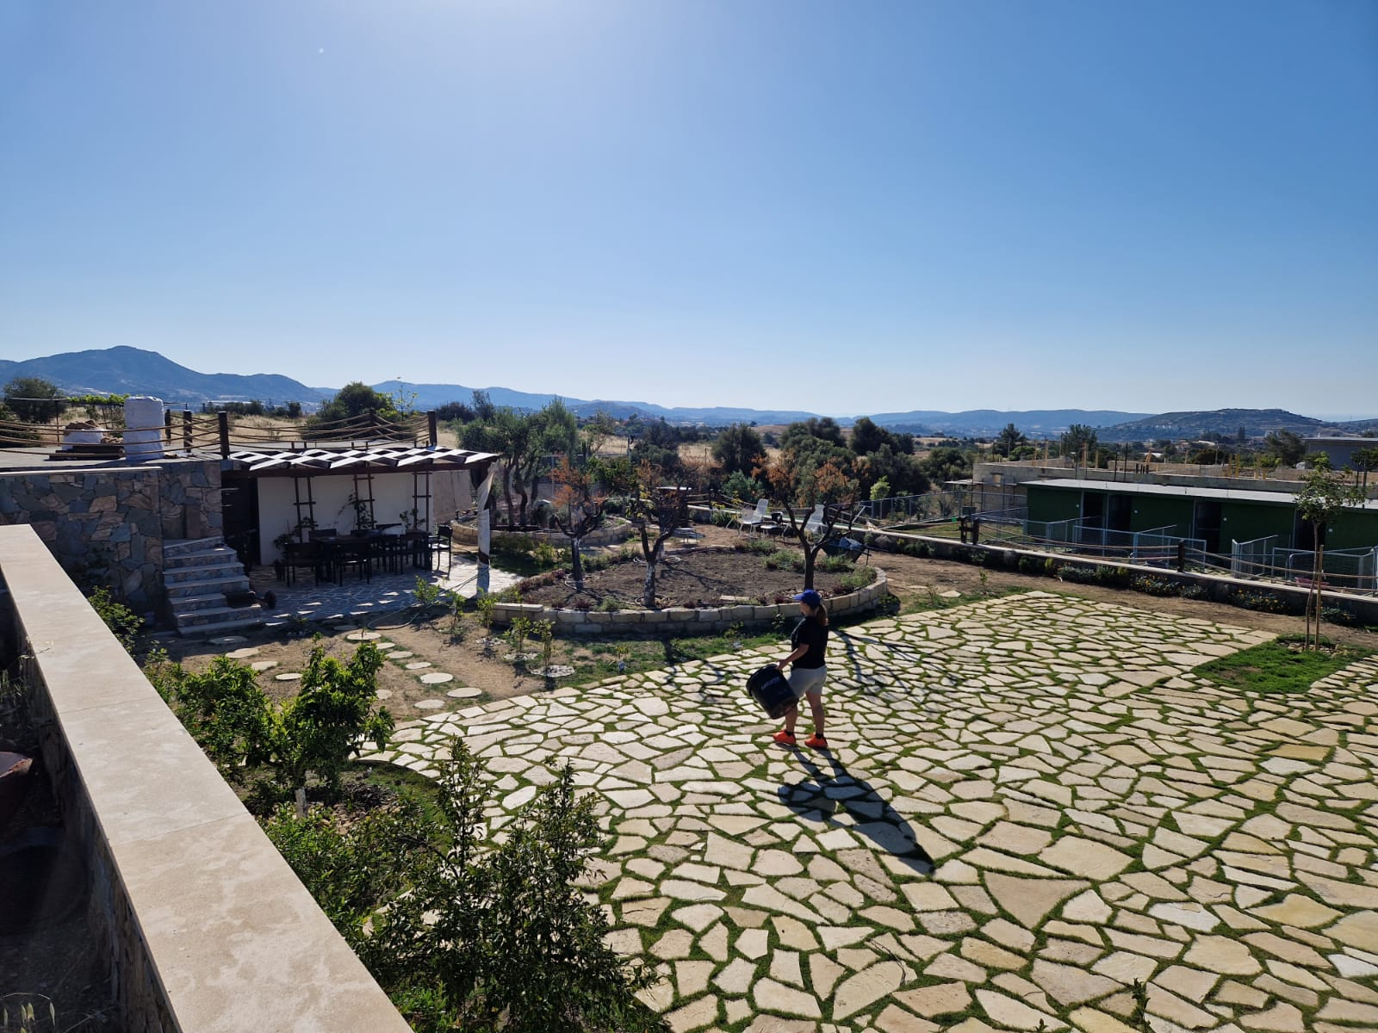
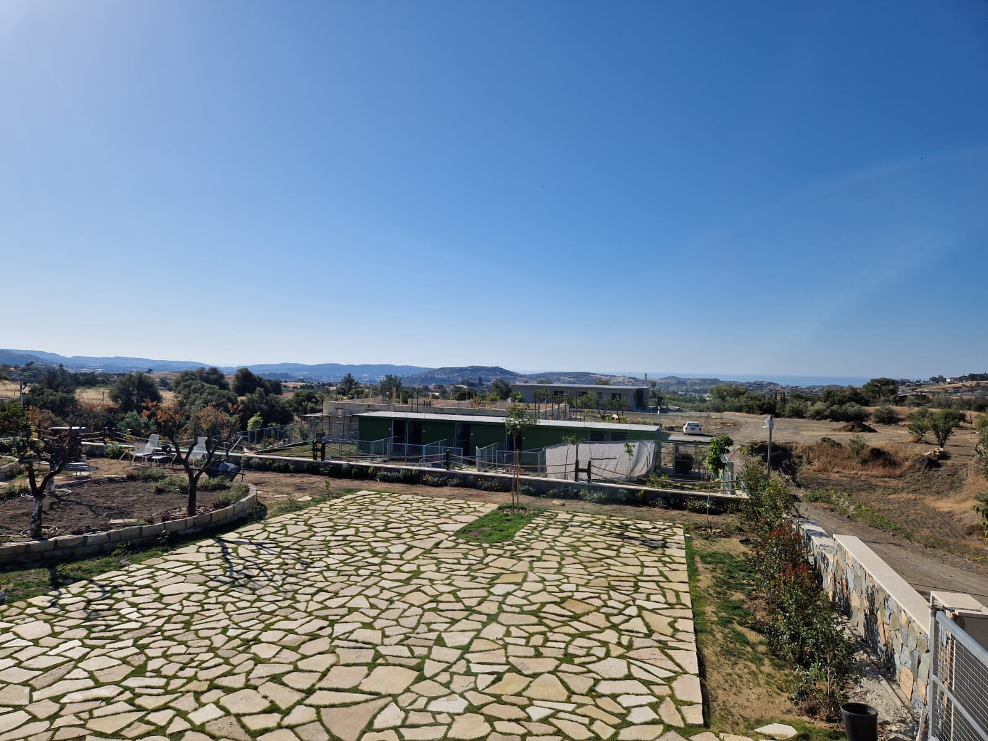

Slide 4
Introduction
In this research we will try to show water requirements for fruits (black mulberries, aronia, pomegranate, carob, white mulberries, olives, lemon, quince, apricot, pomelo, orange, goji, fig tree, chestnut and loquat) grown in VET Centre Kleos in winter (December, January and February) and summer (June, July, August) months.
In the VET centre, 16 lines drop irrigation is used to supply water for these plants.
First, we observed and found out the amount of water currently used in droppers per hour. After that we checked the water requirements for each individual plant.
To calculate the required irrigation requirements, we used data about average rainfall and temperature in Parekklisia, Limassol, Cyprus.

Slide 5
Input
Line 1 | Type of trees | Number of trees | Water per plant | Droppers | Comment
 | Black mulberries | 27 | 7.5 l/h | 1 | Black mulberries need 9,5 liters of water per week
 | Aronia | 15 | 7.5 l/h | 1 | Aronia water needs are 500-700 liters yearly
 | Pomegranate | 2 | 22.5 l/h | 3 | Pomegranates need 24 liters of water per week
The following table shows types of trees, number of trees of each type, measured water per drops, the number of droppers and the official water requirements for each species.

Slide 6
Line 2 | Type of trees | Number of trees | Water per plant | Droppers | Comment
 | Carob | 2 | 16.5 l/h | 2 | Carob needs 250-550 liters of water per year
 | White mulberries | 2 | 16.5 l/h | 2 | White mulberries need 25,4 liters of water per week.
 | Fig tree | 2 | 16.5 l/h | 2 | A fig tree needs 25-37 liters of water per week
 | Chestnut | 2 | 16.5 l/h | 2 | Chestnut needs 4 liters of water per week, if temperature is high they need 8 liters of water per week
 | Loquat | 2 | 16.5 l/h | 2 | They need 25,4 liters per week when temperature is high
 | Pomegranate | 12 | 16.5-22.75 l/h | 2/3 | Pomegranates need 24 liters of water per week

Slide 7
Line 3 | Type of trees | Number of trees | Water per plant | Droppers | Comment
 | Aronia | 85 | 8.25 l/h | 1 | Aronia water needs are 500-700 liters yearly

Slide 8
Line 4 | Type of trees | Number of trees | Water per plant | Droppers | Comment
 | Olives | 4 | 20,4 l/h | 3 | Olives water needs are 17-20 liters per week
 | Lemon | 7 | 20,4 l/h | 3 | Lemon water needs are 18.5 liters per week
 | Loquat | 3 | 13,6 l/h | 2 | Loquat need 25,4 liters per week when temperature is high
 | Quince | 2 | 13,6 l/h | 2 | Quince needs 21 liters of water per week
 | Apricot | 4 | 13,6 l/h | 2 | Apricot needs 3,5 liters of water every 10 days.
 | Pomelo | 1 | 13,6 l/h | 2 | Pomelo needs 480 liters of water per year and the soil should be moist during the growing season
 | Avocado | 2 | 13,6 l/h | 2 | Avocado needs 51 liters of water per week
 | Tangerine | 2 | 20,4 l/h | 3 | Tangerine needs 400 liters of water per year
 | Orange | 4 | 20,4 l/h | 3 | Orange needs 450 liters of water per year
 | Carob | 2 | 20,4 l/h | 3 | Carob needs 250-550 liters of water per year

Slide 9
Line 5 | Type of trees | Number of trees | Water per plant | Droppers | Comment
 | Aronia | 68 | 7.5l/h | 1 | Aronia water needs are 500-700 liters yearly

Slide 10
Line 7 | Type of trees | Number of trees | Water per plant | Droppers | Comment
 | Goji berries | 47 | 13.5l/hour | 1 | Goji barriers water needs are 350-500 liters yearly

Slide 11
Line 8 | Type of trees | Number of trees | Water per plant | Droppers | Comment
 | Aronia | 58 | 13.3l/hour | 1 | Aronia water needs are 500-700 liters yearly

Slide 13
Average yearly rainfall in Parekklisia, Limassol, Cyprus
Rainfall in Parakklesia is about 96,73 l liters annually (8,07 per month).
In winter months the average rainfall is 23,2 l (December), 25,4 l (January) and 13,3 (February), which makes 61,9 l (20,63 l average per month) in 3 winter months.
In the rest of the year there is less precipitation: March: 7,6; April 3,4; May: 4,1; June: 0,9; July; 0.2; August: 0,4; September: 1,6; October; 8,1; November: 8,6, which makes 34,83 l (an average of 3,87 liter per month) in spring/summer/autumn.
Especially dry months are summer months June, July and August with 1,5 l of precipitation (0,5 on average).

Slide 14
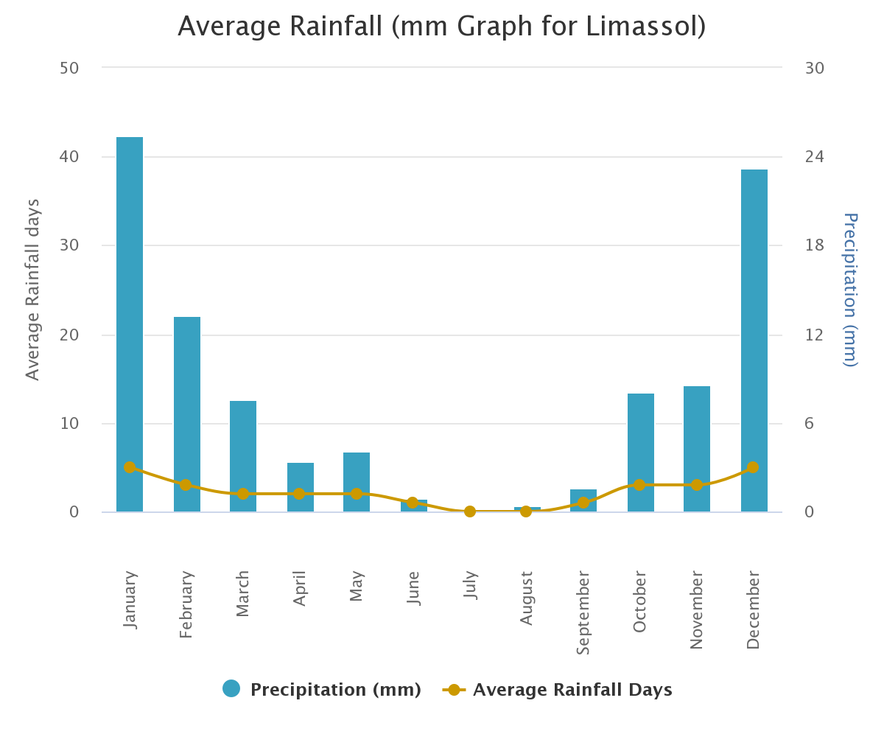

Slide 15
Average yearly temperature in Parekklisia, Limassol, Cyprus
According to https://en.climate-data.org/asia/cyprus/limassol/limassol-15/ the average annual temperature in Parakklesia is 20.3 °C.
In winter months (December, January, February) the average temperature is 12,86 °C, and in the rest of the year (March – November) it is 22,73 °C. Average temperature in summer months (June-August) is 28,46 °C.

Slide 16
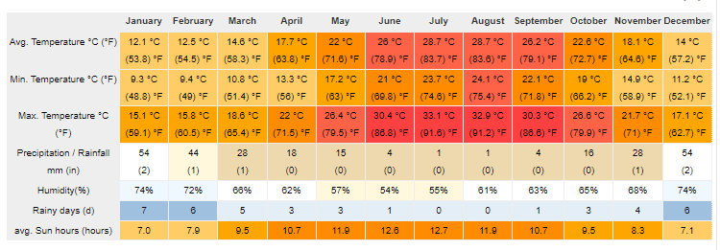

Slide 17
Findings
Tree type | Current water supply through irrigation | Water requirements | Comment: Limassol rainfall: 96,73 l/y Winter: 61,9 l rainfall/5,16 l a week Summer: 1,5 l rainfall/0,16 a week

Slide 18
Carob | 16.5 l/h | 9,52 l/week 250-550 l/y (400 l on average) | It requires on average 300 l/y additional irrigation. Winter: 4,36 l a week (0,26 hours a week) Summer: 9,36 l a week (0,57 hours a week)
White mulberries | 16.5 l/h | 25,4 l/week | Winter: 20,24 l a week (0,6 hours a week) Summer: 25,24 l a week (0,77 hours a week)
Fig tree | 16.5 l/h | 25 – 37 l/week (30 on average) | Winter: 24,84 l a week (0,75 hours a week) Summer: 29,84 l a week (0,91 hours a week)
Chestnut | 16.5 l/h | 4/8 l/week | Winter: no additional irrigation Summer: 7,84 l a week (0,24 hours a week)
Loquat | 16.5 l/h | 25 l/week | Winter: 19,84 l a week (0,6 hours a week) Summer: 24,84 l a week (0,75 hours a week)

Slide 19
Pomegranate | 16.5-22.75 l/h (20 l on average) | 1270-1524 l/year 29,31 l/week | It requires on average 1300 l/y additional irrigation. Winter: 24,15 l a week (1,2 hours a week) Summer: 29,15 l a week (1,46 hours a week)
Aronia | 7,5 l/h 8,25 l/h | 500-700 l/year 13,46 l/week | It requires on average 500 l/y additional irrigation. Winter: 8,3 l a week (1,06 hours a week) (0,97 hours a week) Summer:13,3 l a week (1,77 hours a week) (1,61 hours a week)

Slide 20
Black mulberries | 7,5 l/h | 9,5 l/week | Winter: 4,34 l a week (0,36 hours a week) Summer: 9,34 l a week (0,78 hours a week)
Olives | 20,4 l/h | 17-20 l/week | Winter: 14,84 l a week (0,72 hours a week) Summer: 18,5 l a week (0,90 hours a week)
Lemon | 20,4 l/h | 18,5 l/week | Winter: 13,34 l a week (0,66 hours a week) Summer: 18,34 l a week (0,9 hours a week)
Avocado | 13,6 l/h | 51 l/week | Winter: 45,84 l a week (3,37 hours a week) Summer: 50,74 l a week (3,74 hours a week)
Quince | 13,6 l/h | 21 l/week | Winter:15,84 l a week (1,16 hours a week) Summer: 20,84 l a week (1,53 hours a week)
Apricot | 13,6 l/h | 3,5 l/week | Winter: In winter it is not necessary to irrigate Summer: 3,34 l a week (0,25 hours a week)

Slide 21
Pomelo | 13,6 l/h | 9,23 l/week | Winter: 4,07 l a week (0,3 hours a week) Summer: 9,07 l a week (0,67 hours a week)
Tangarine | 20,4 l/h | 7,69 l/week | Winter: 2,53 l a week (0,15 hours a week) Summer: 7,53 l a week (0,37 hours a week)
Orange | 20,4 l/h | 8,65 l/week | Winter: 3,49 l a week (0,17 hours a week) Summer: 8,49 l a week (0,4 hours a week)
Goji | 13.5l/hour | 9,62 l/week | Winter: 4,46 l a week (0,33 hours a week) Summer: 9,78 l a week (0,72 hours a week)

Slide 22
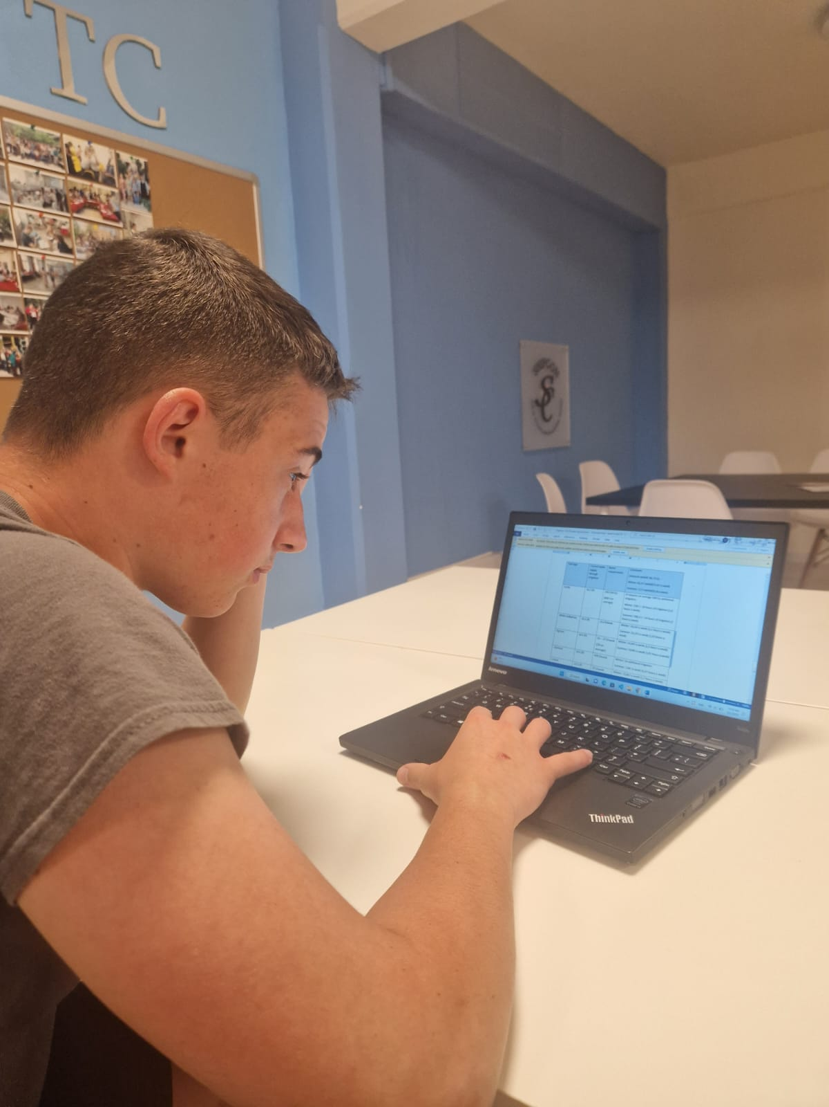
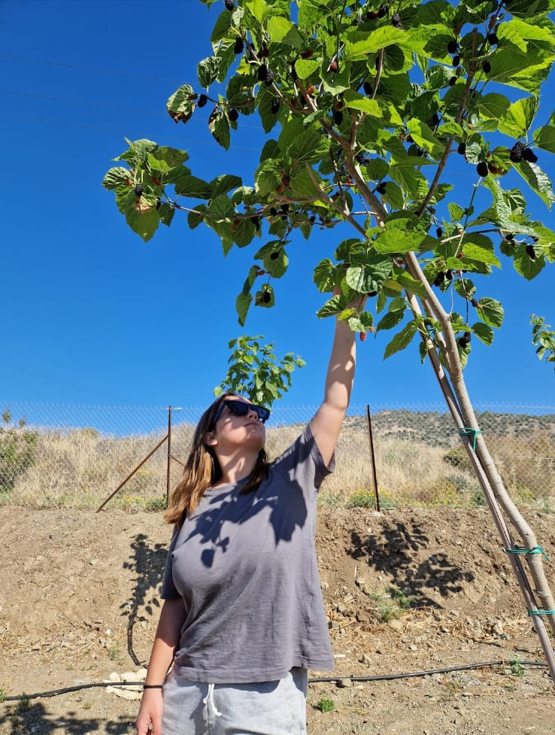

Slide 23
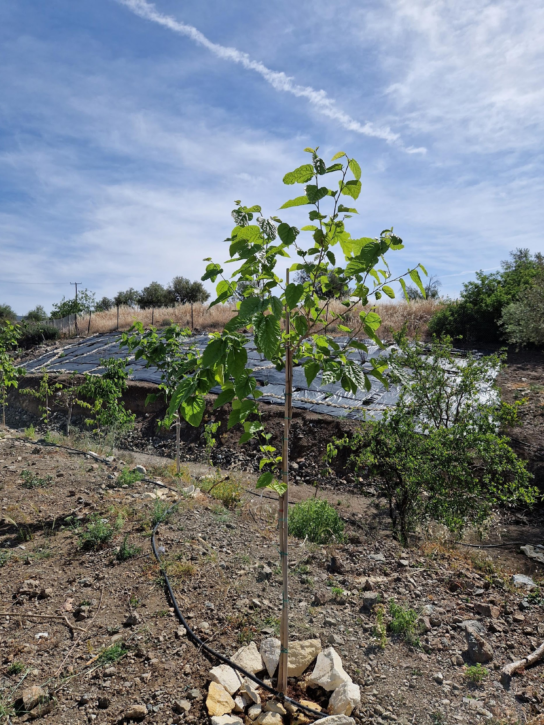
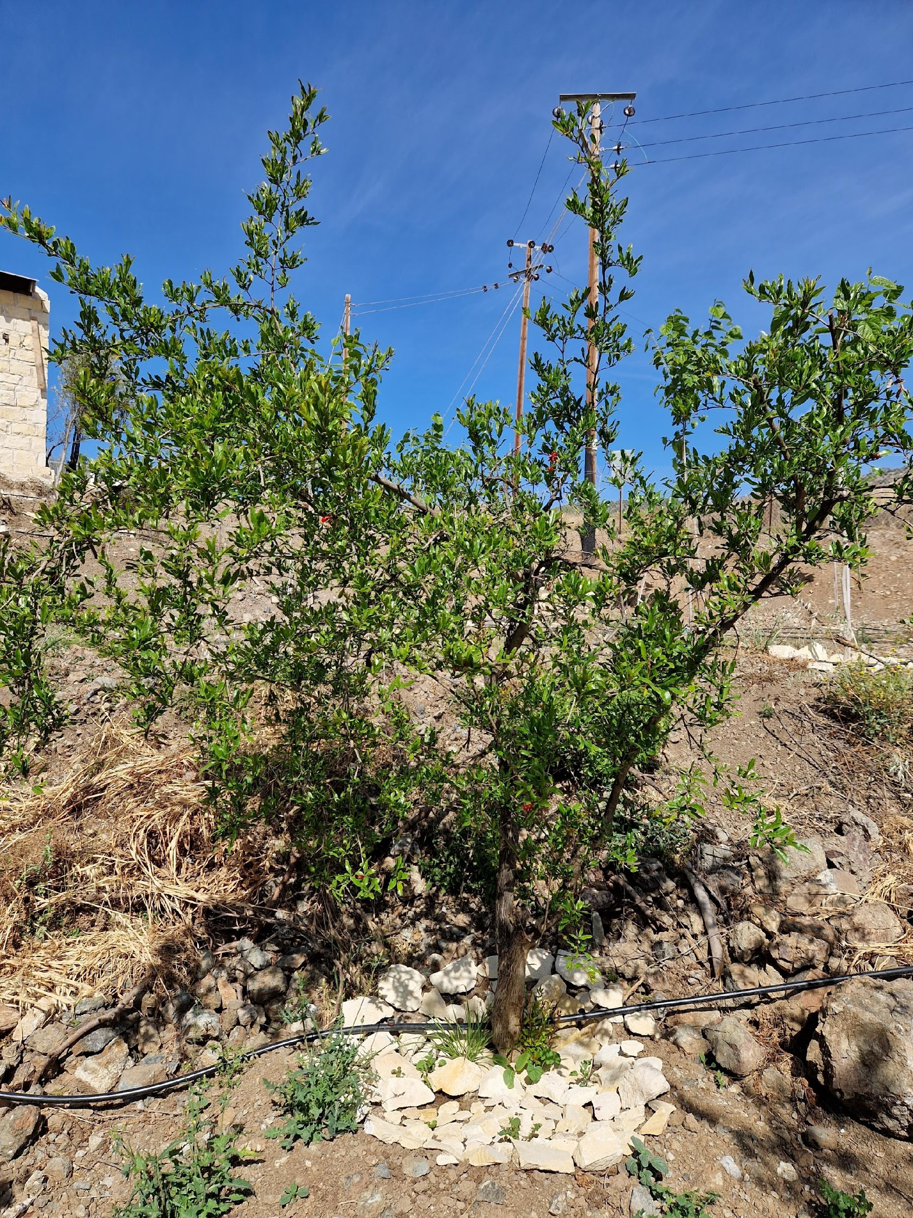
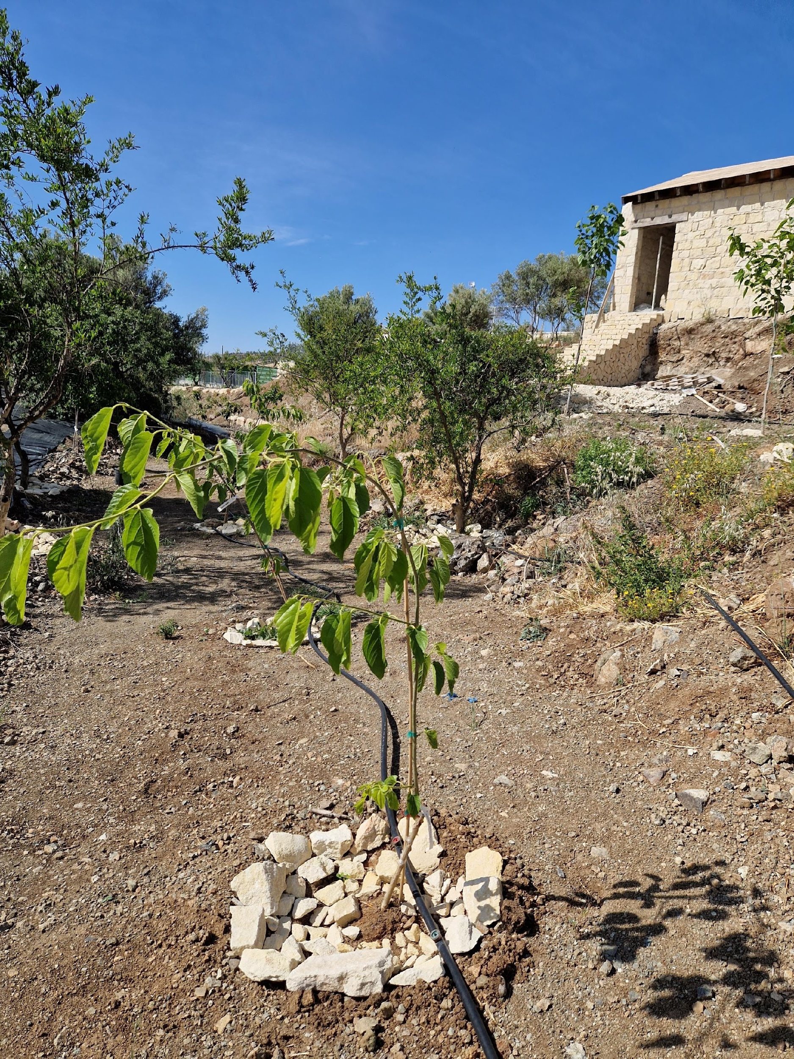
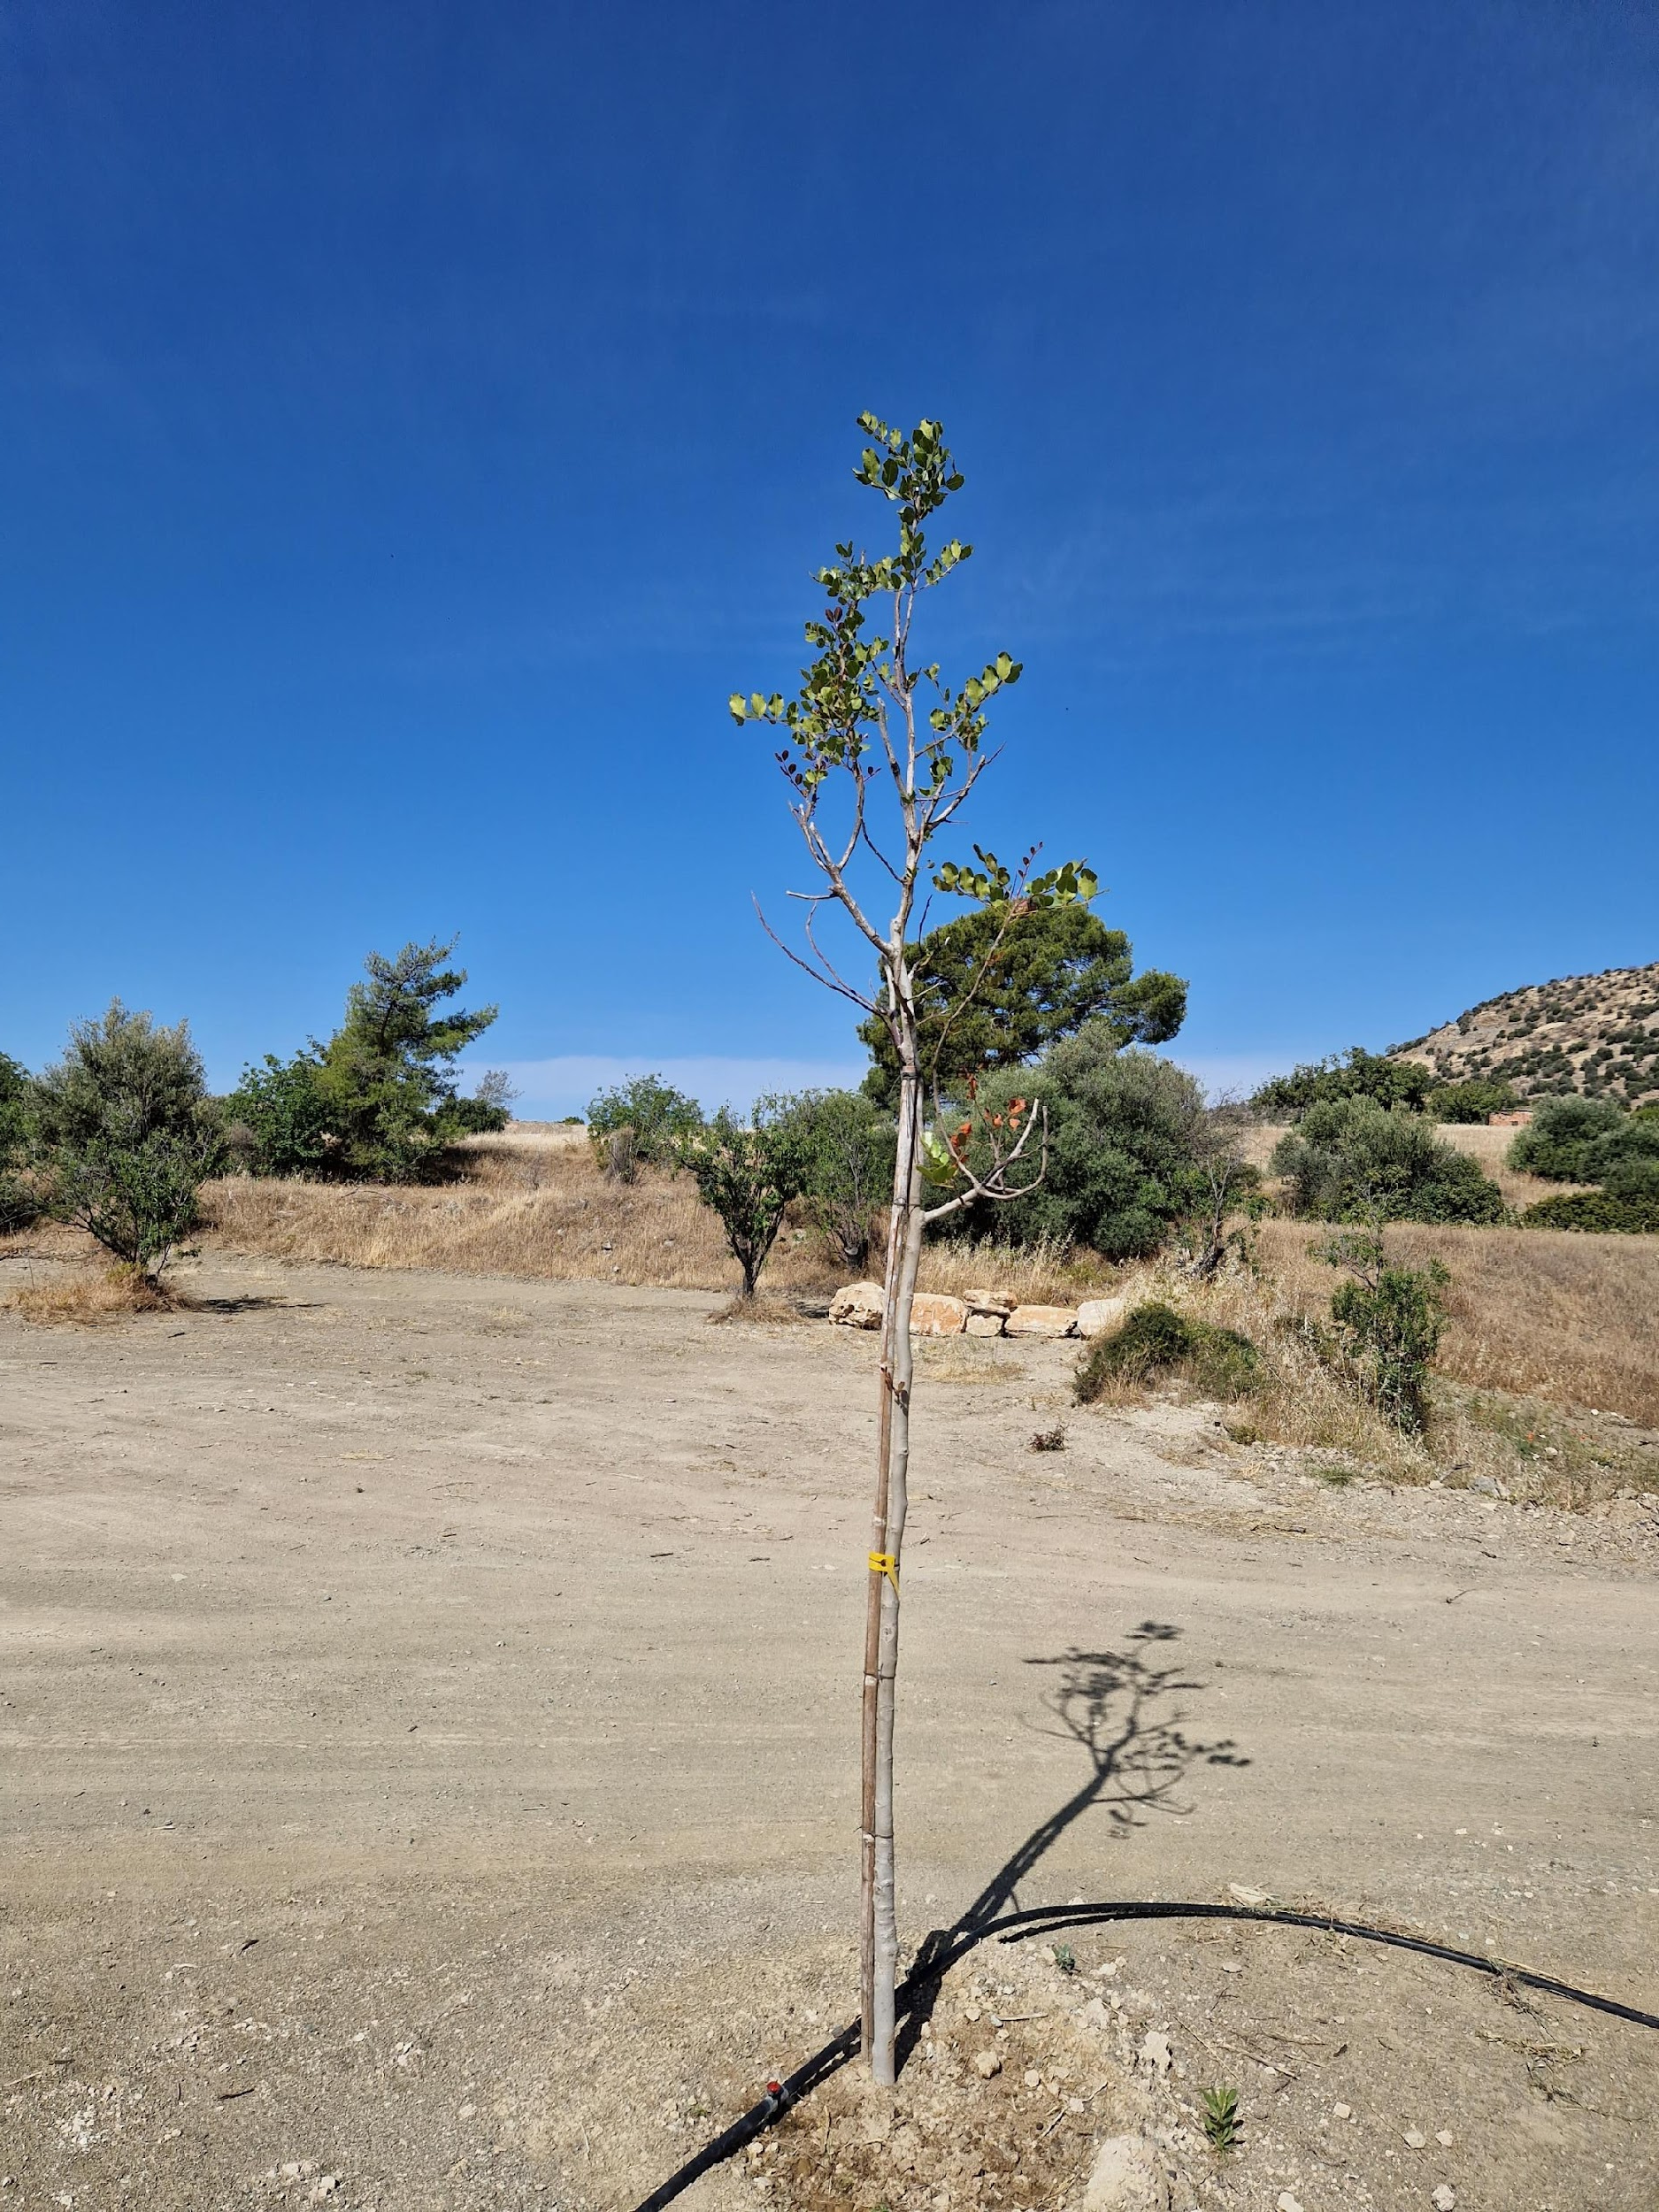
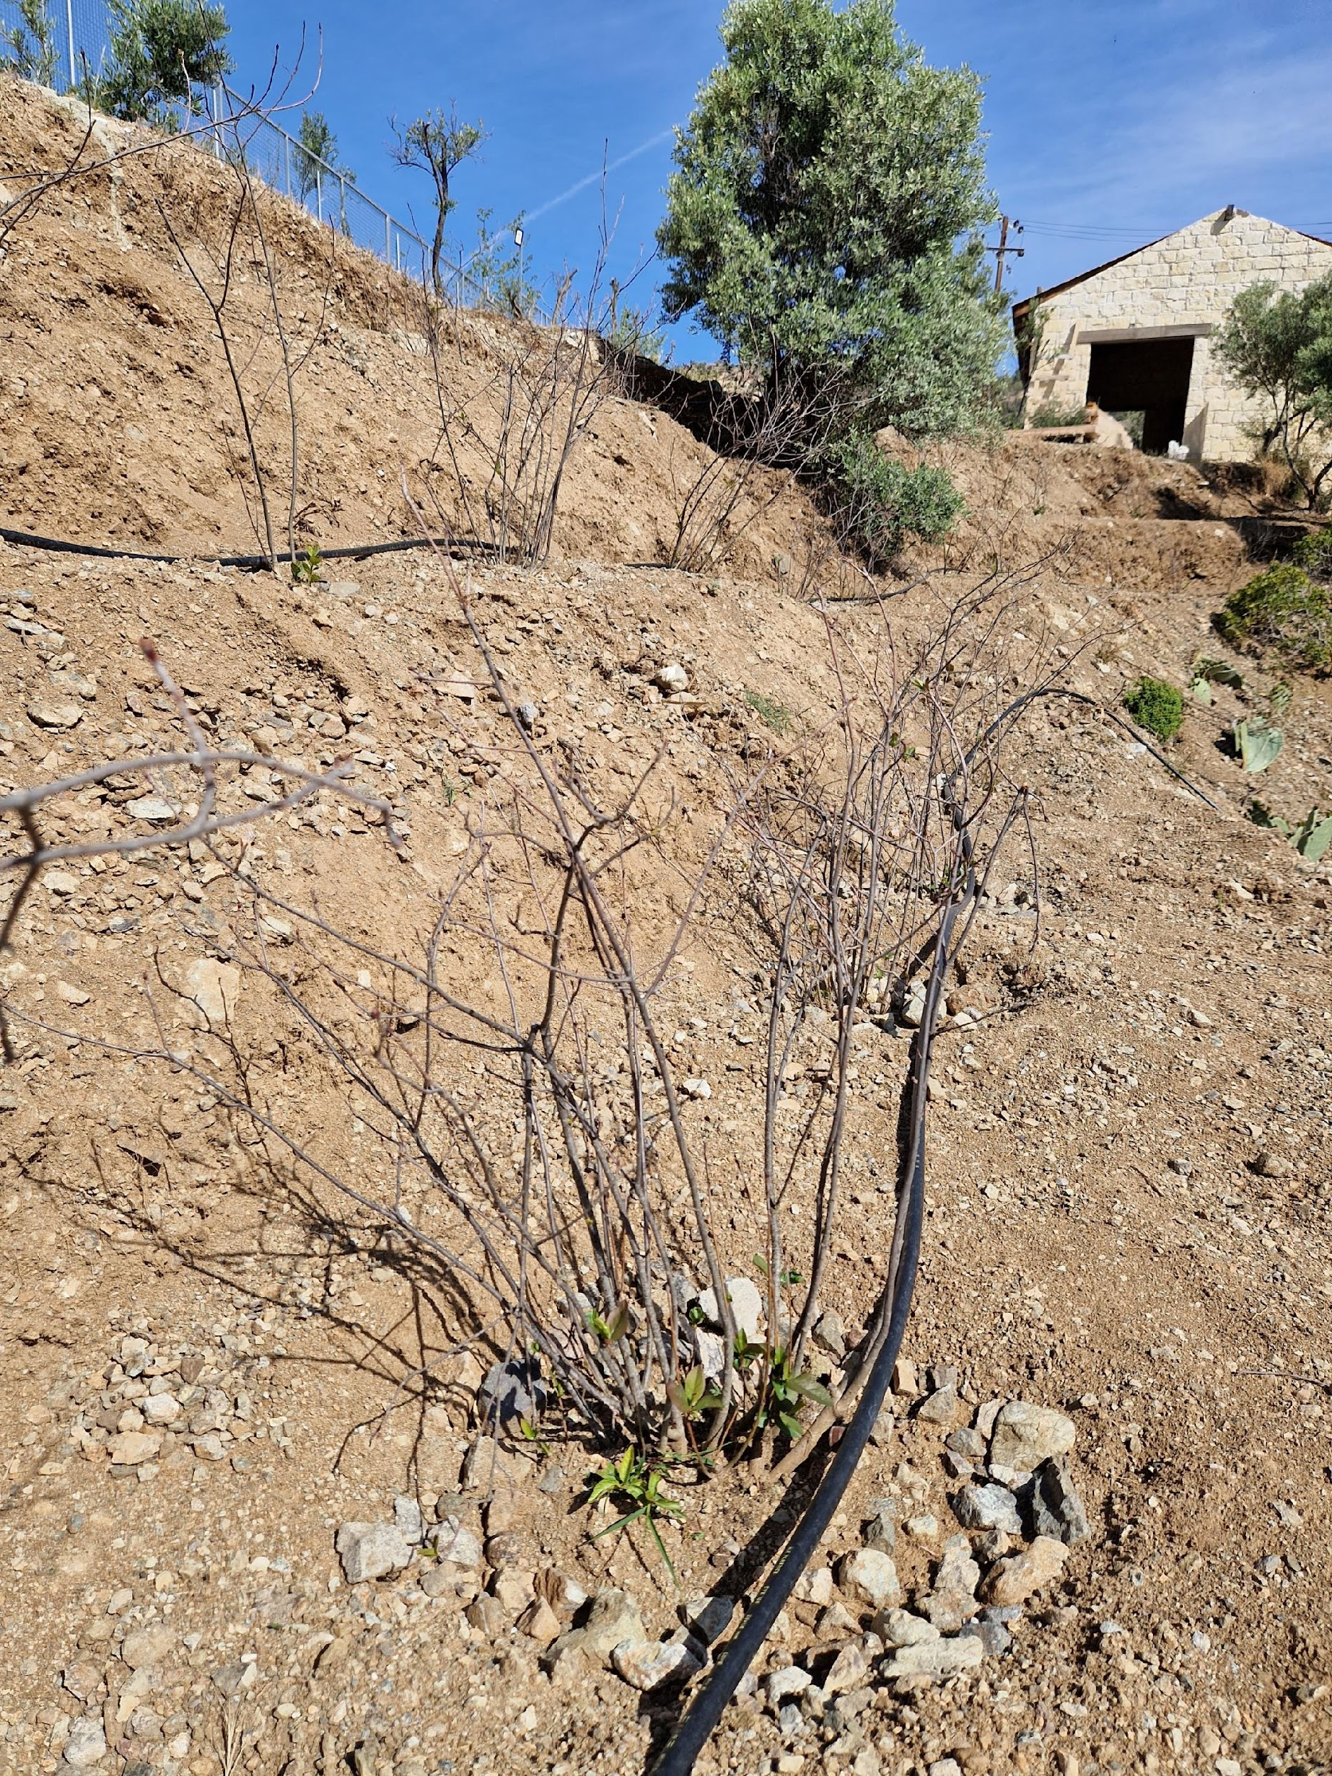
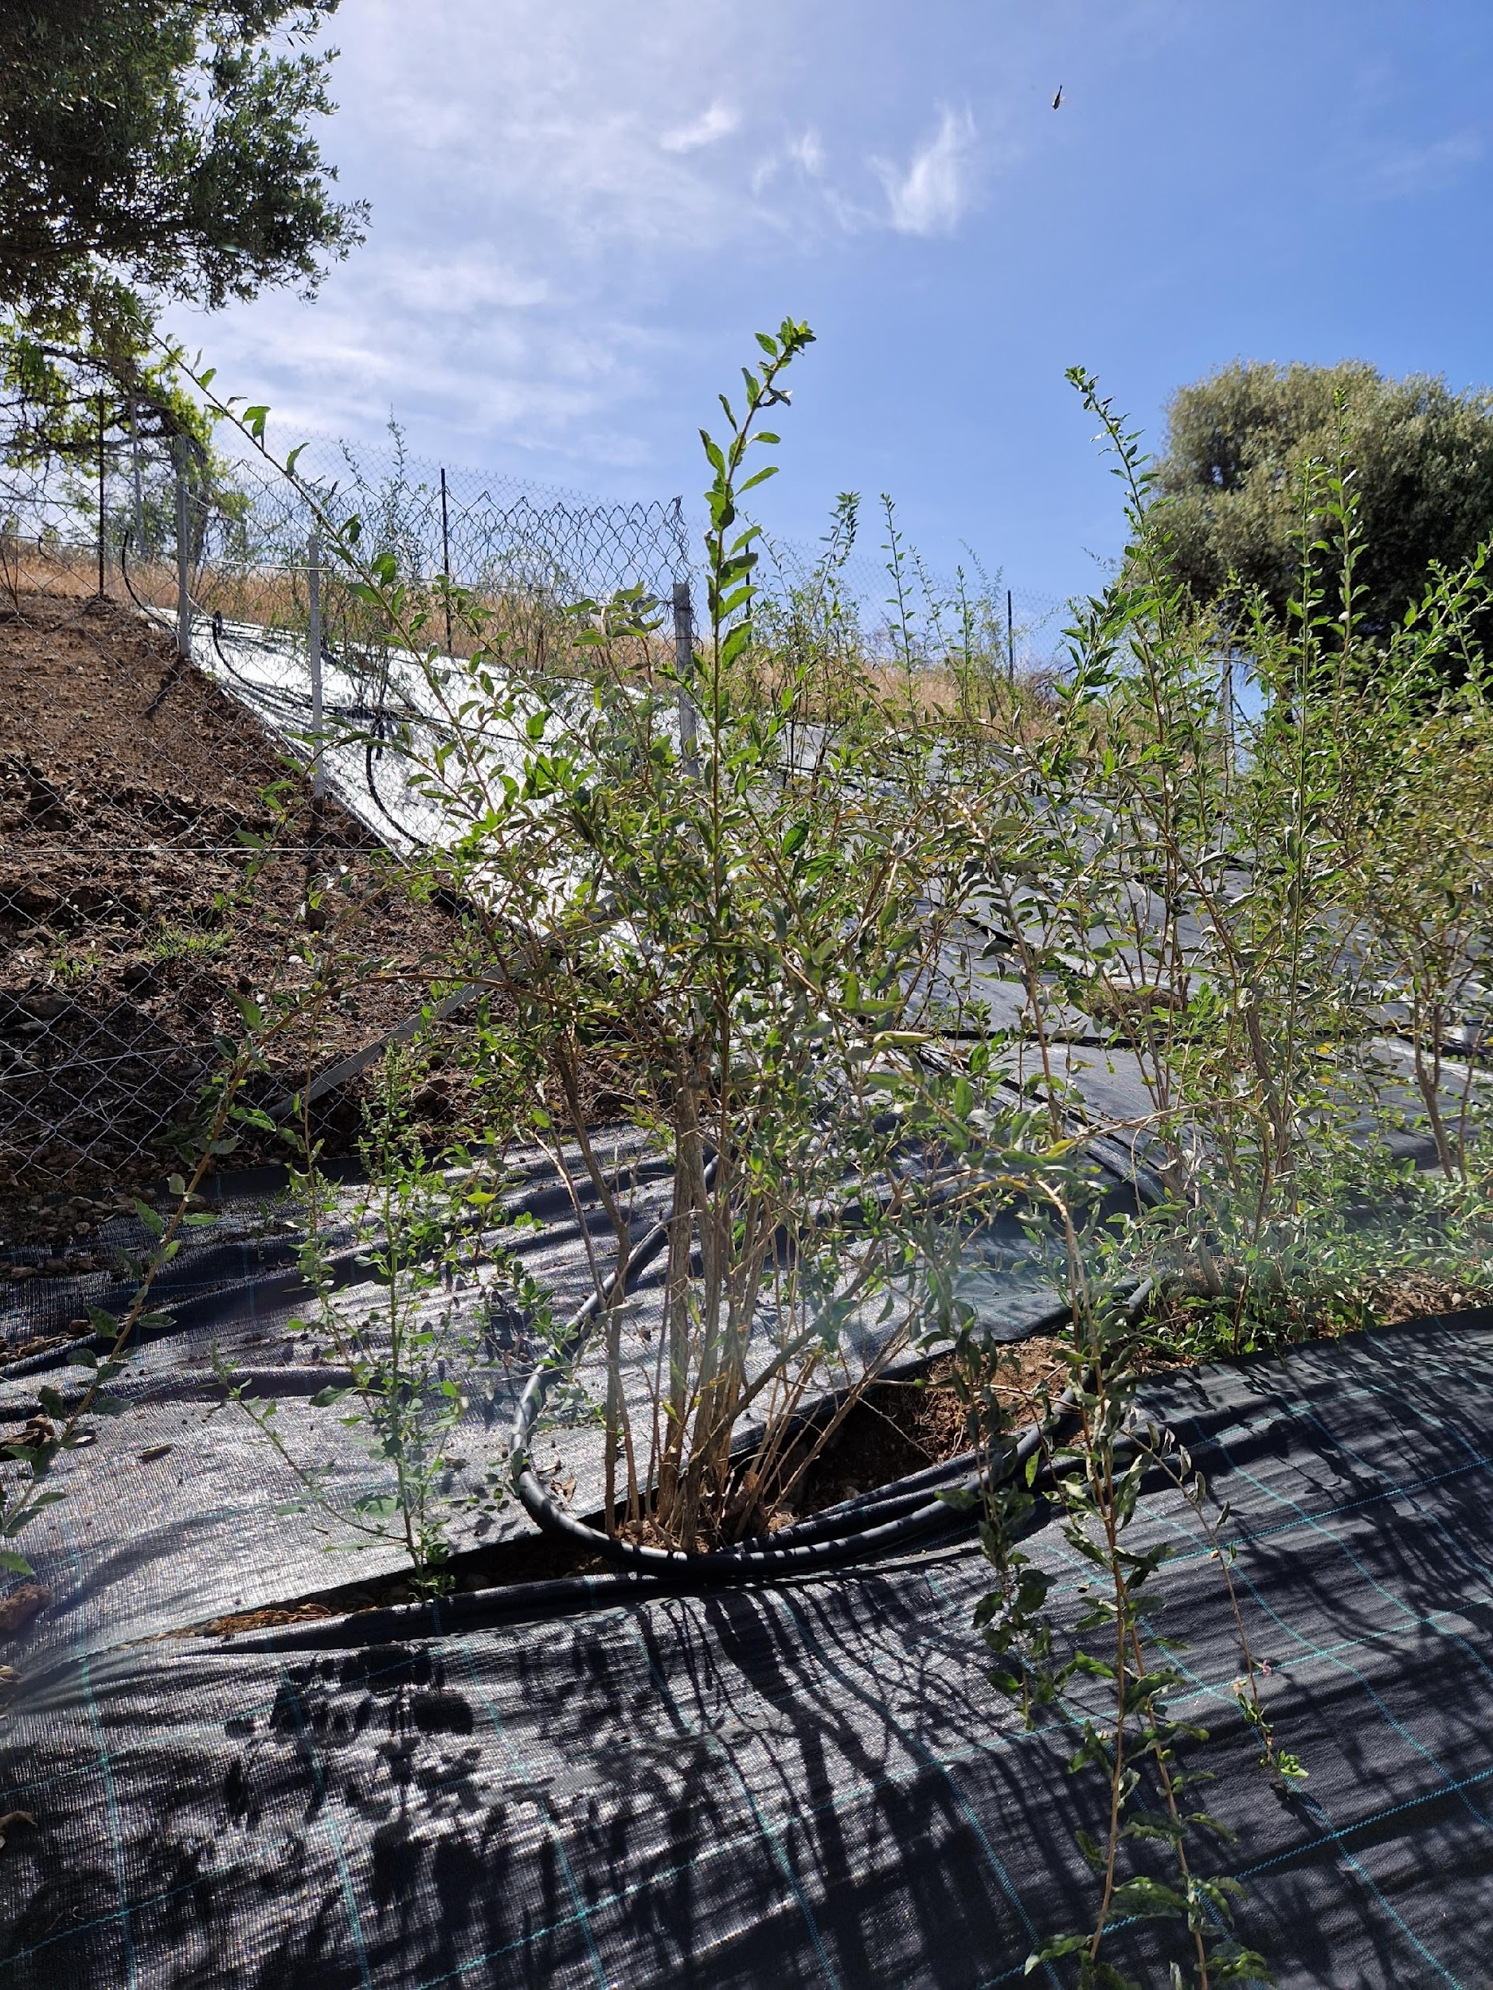
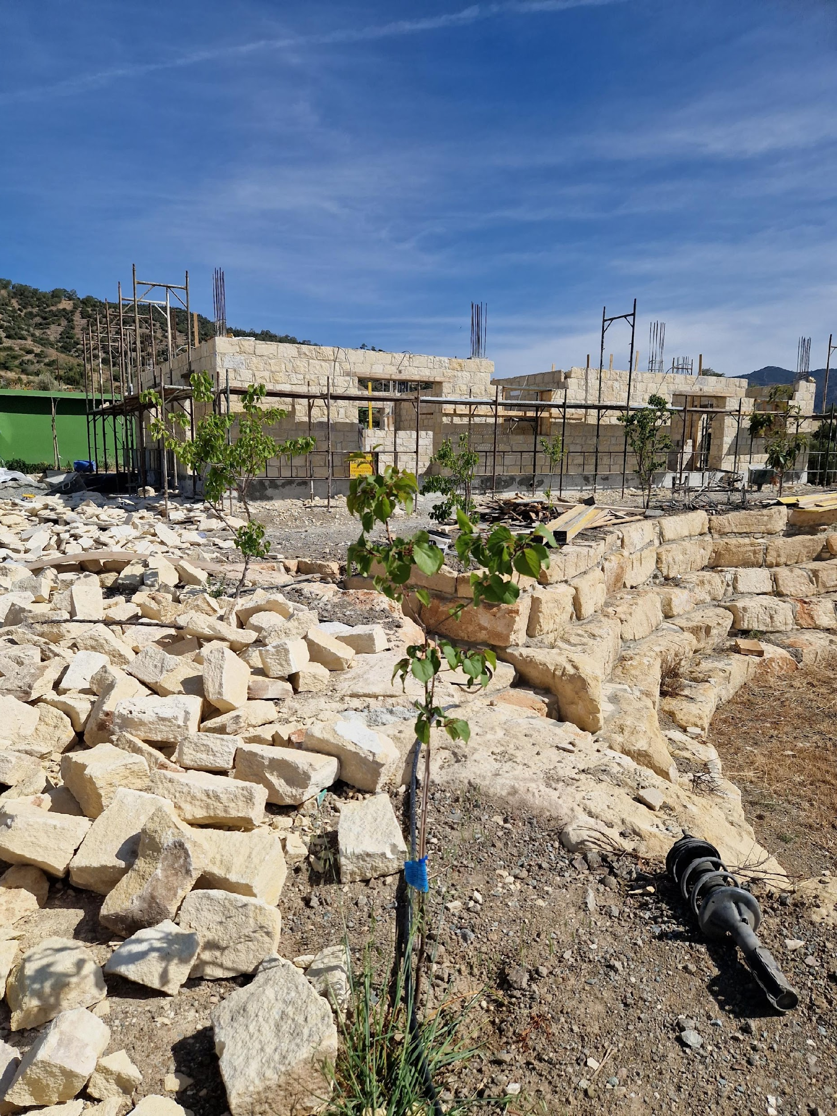
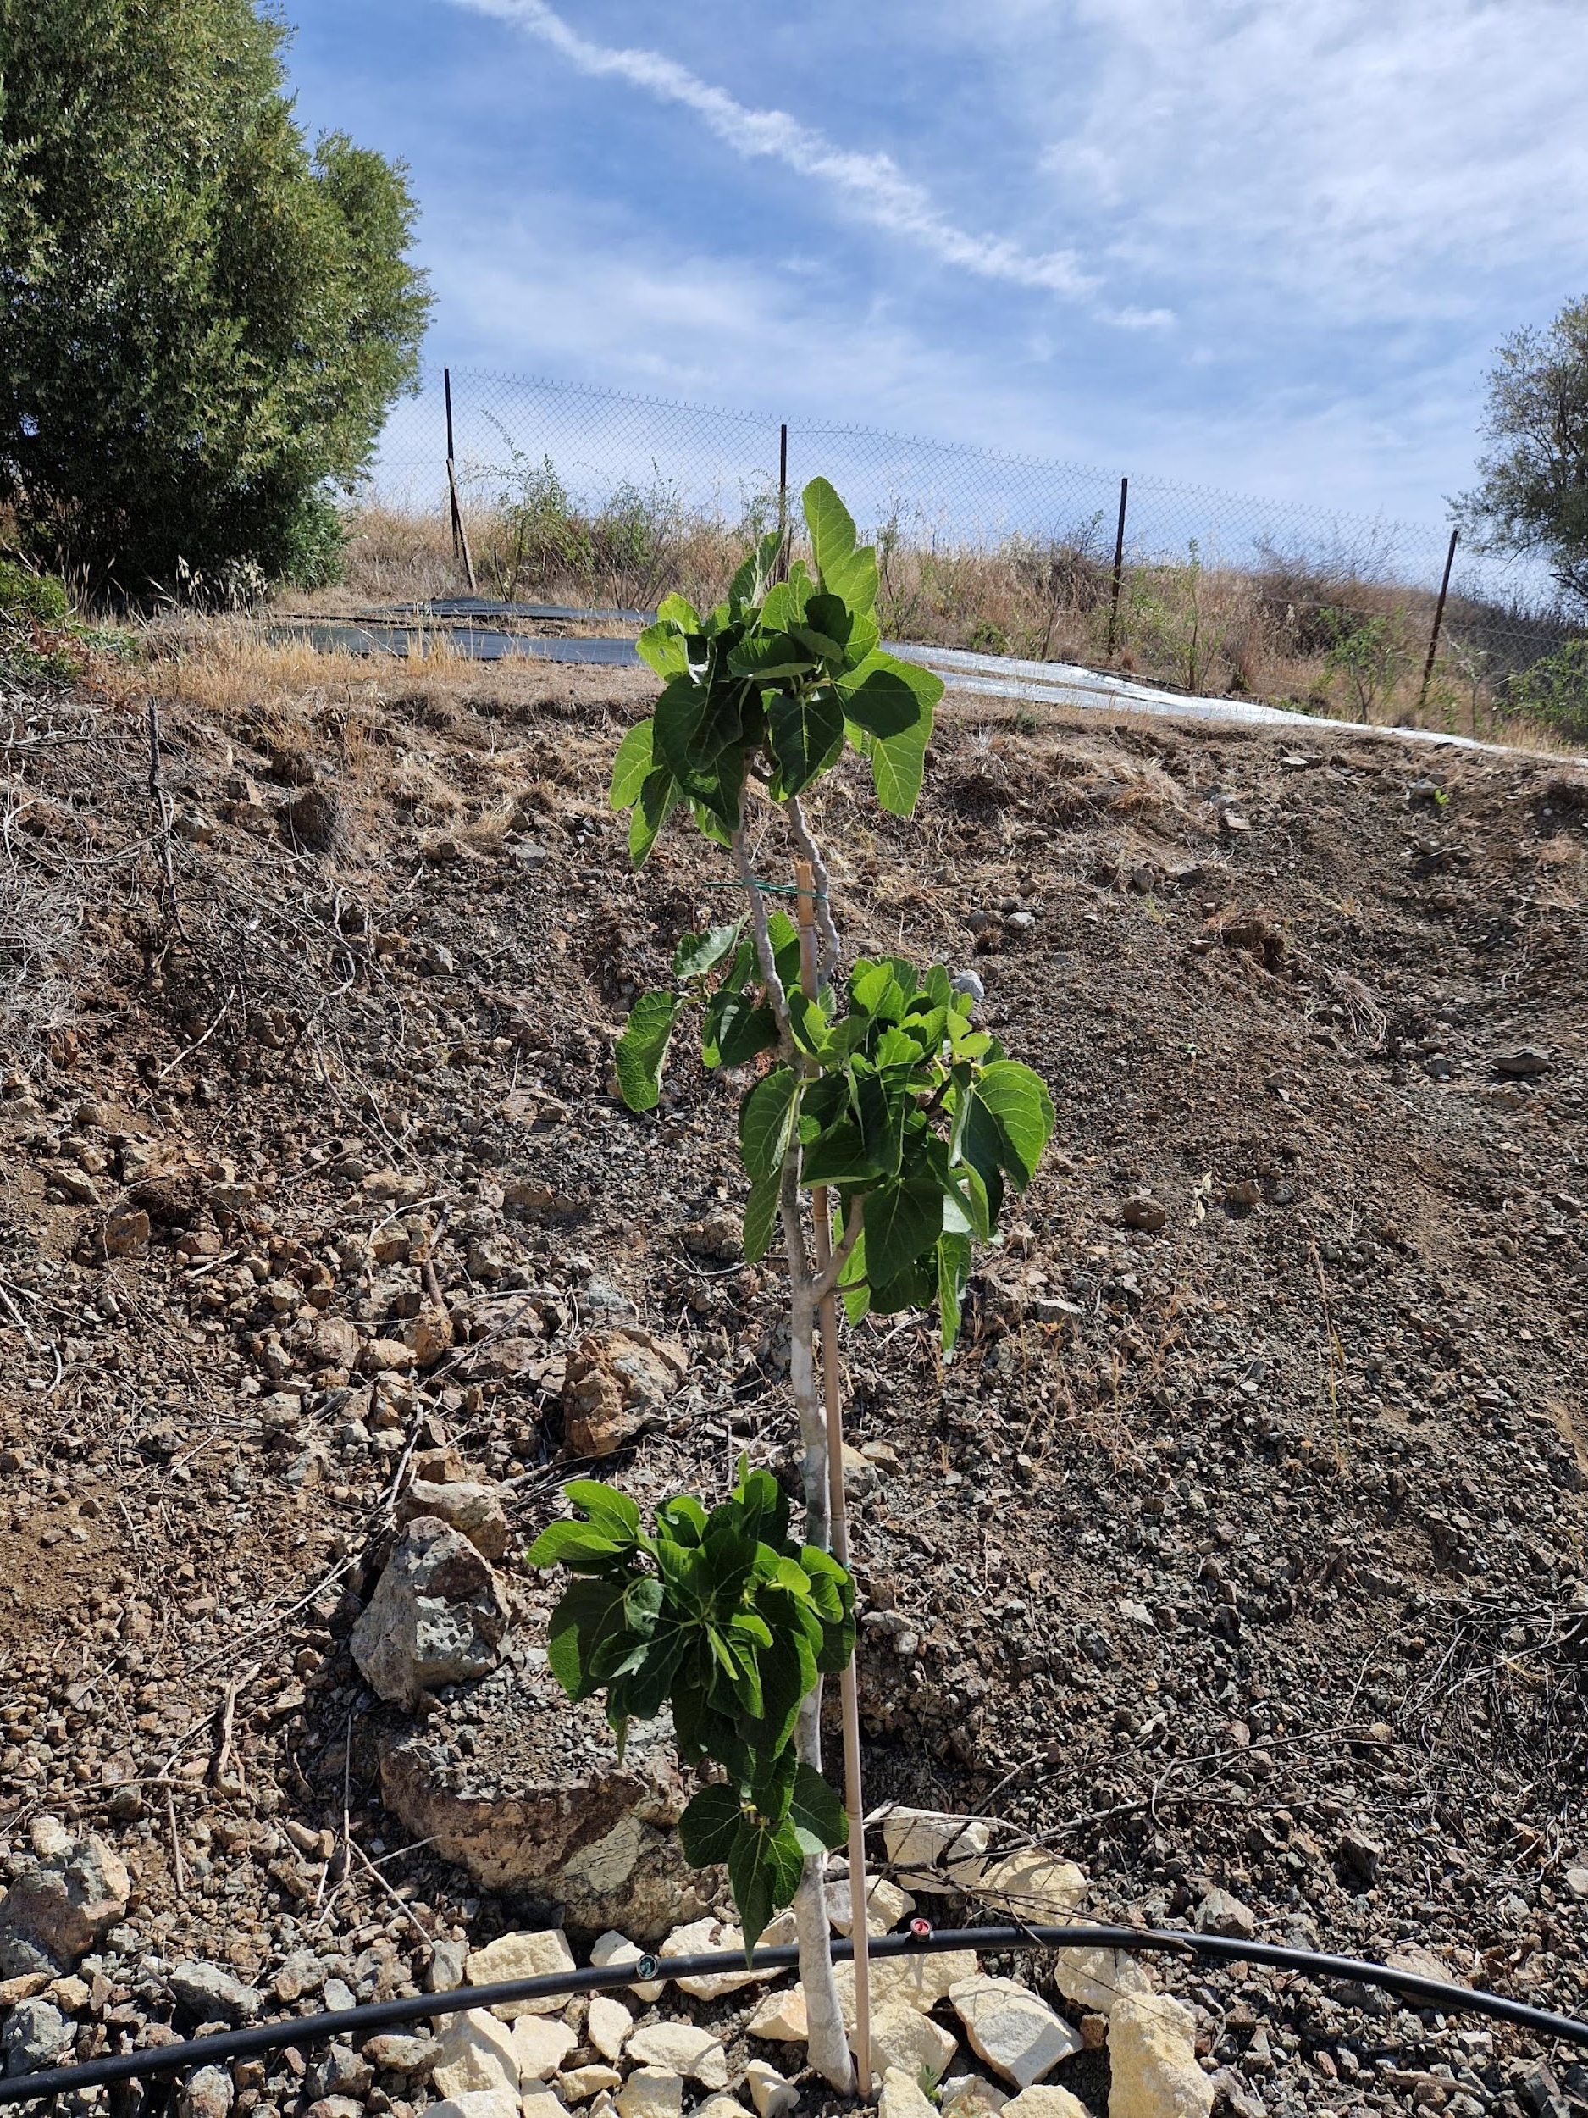
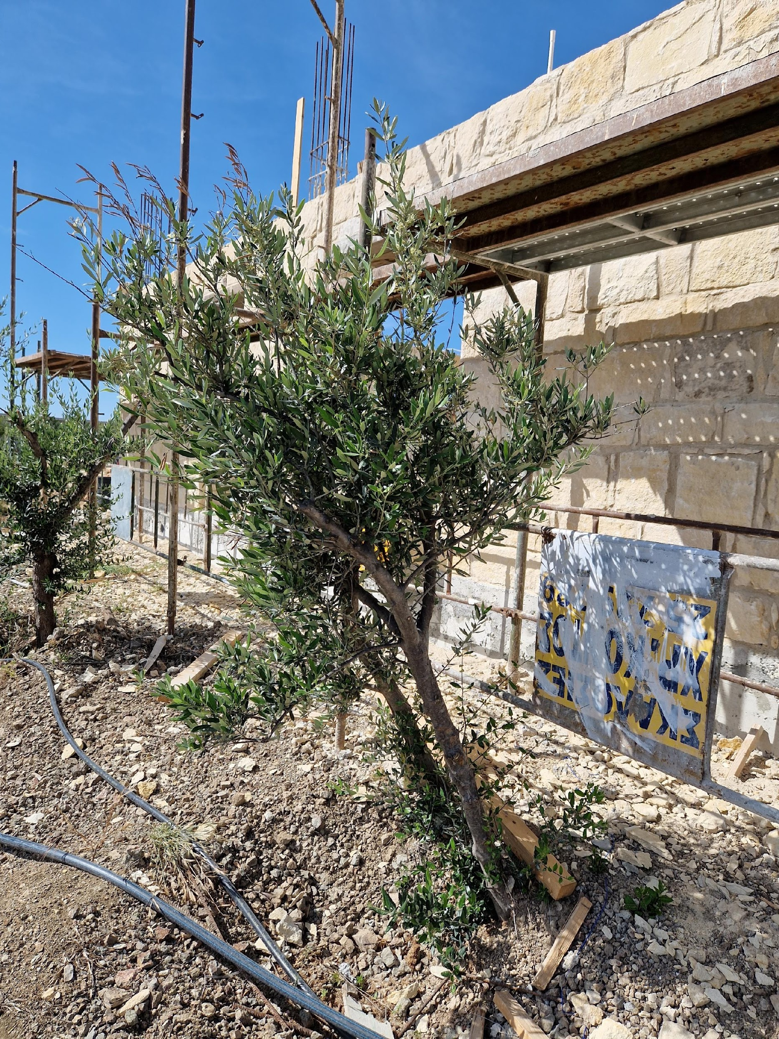
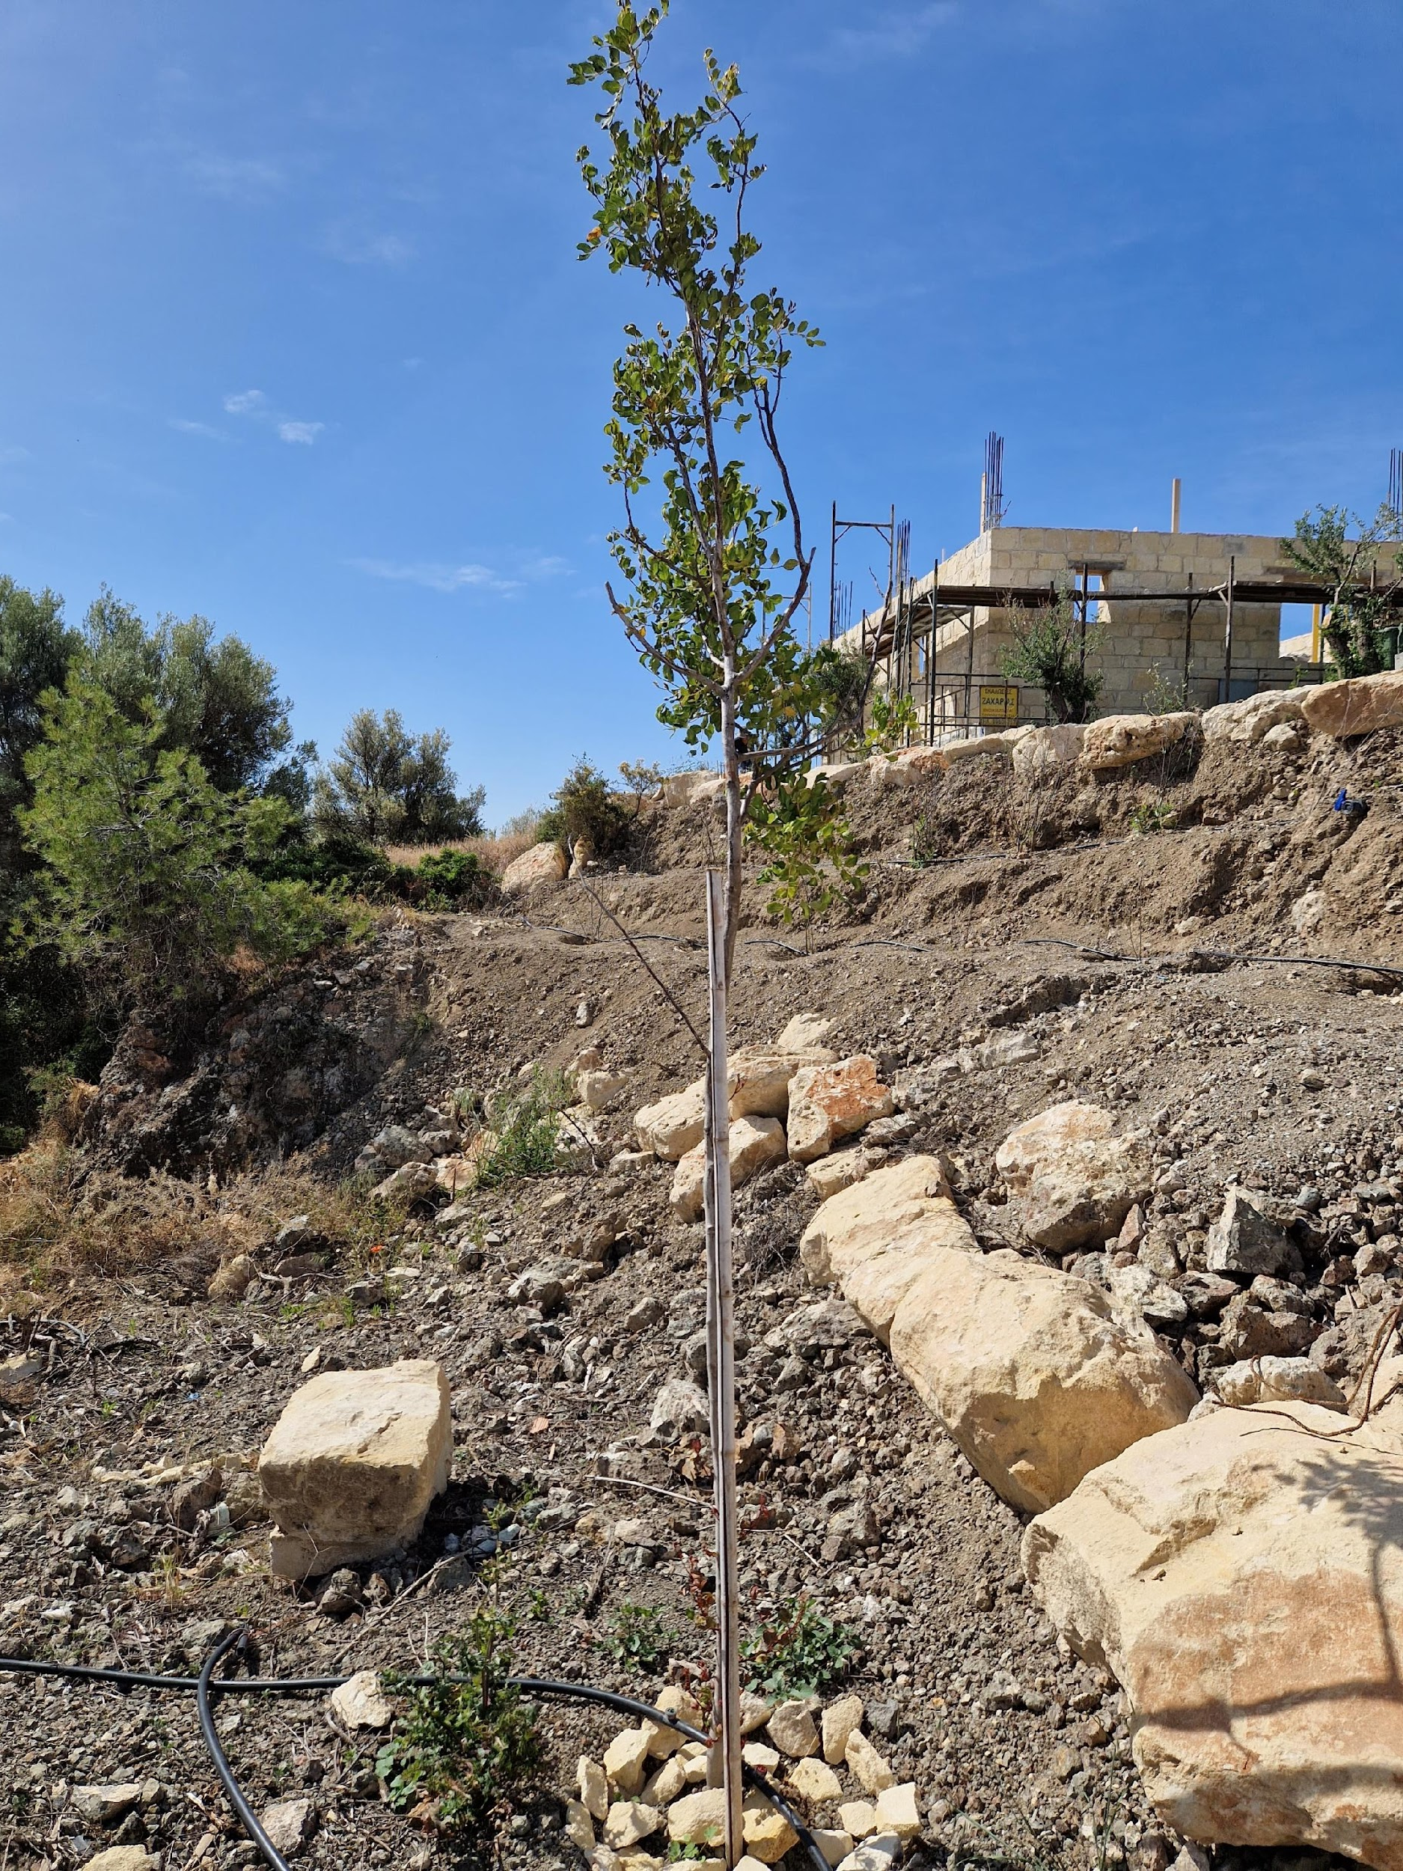
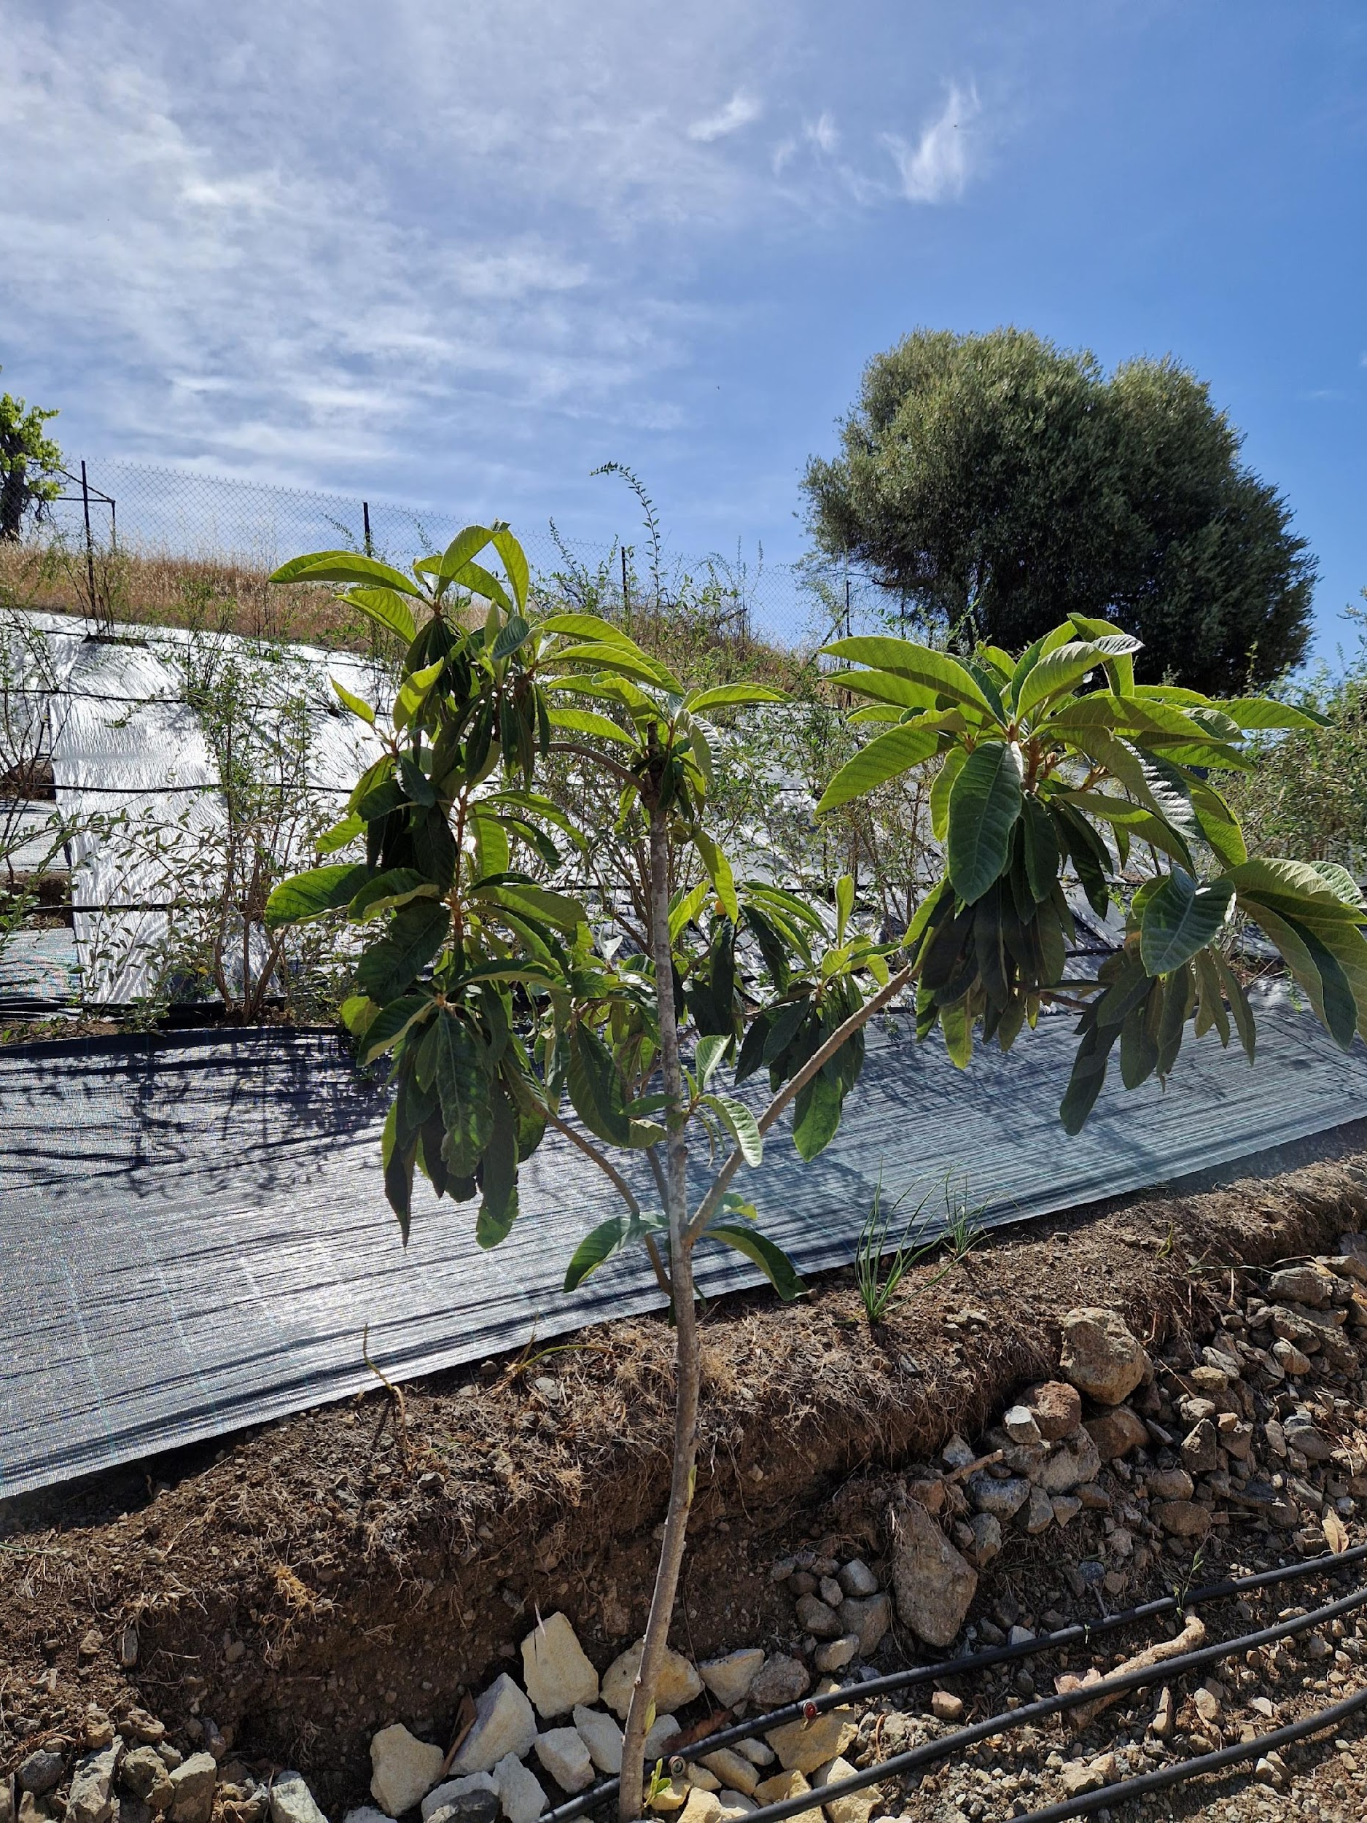
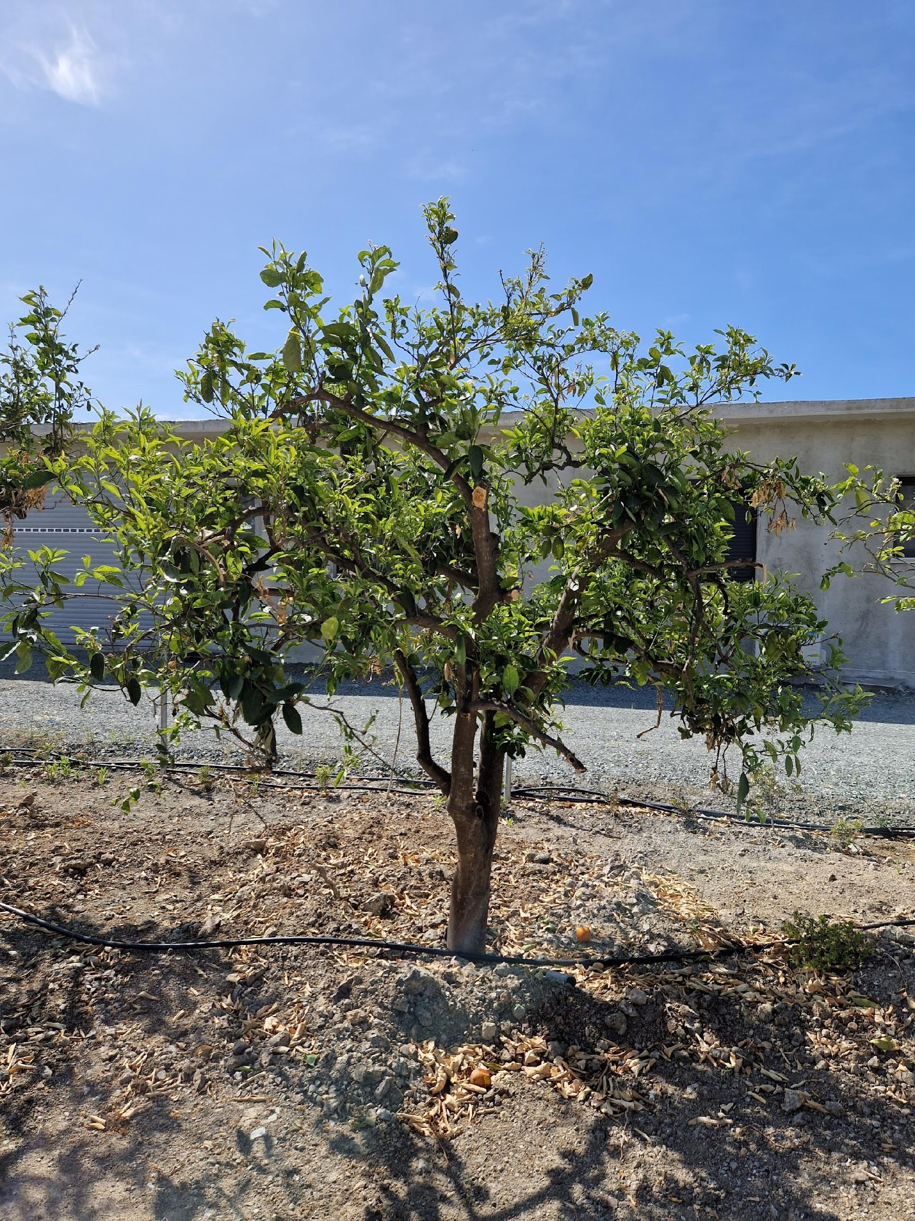
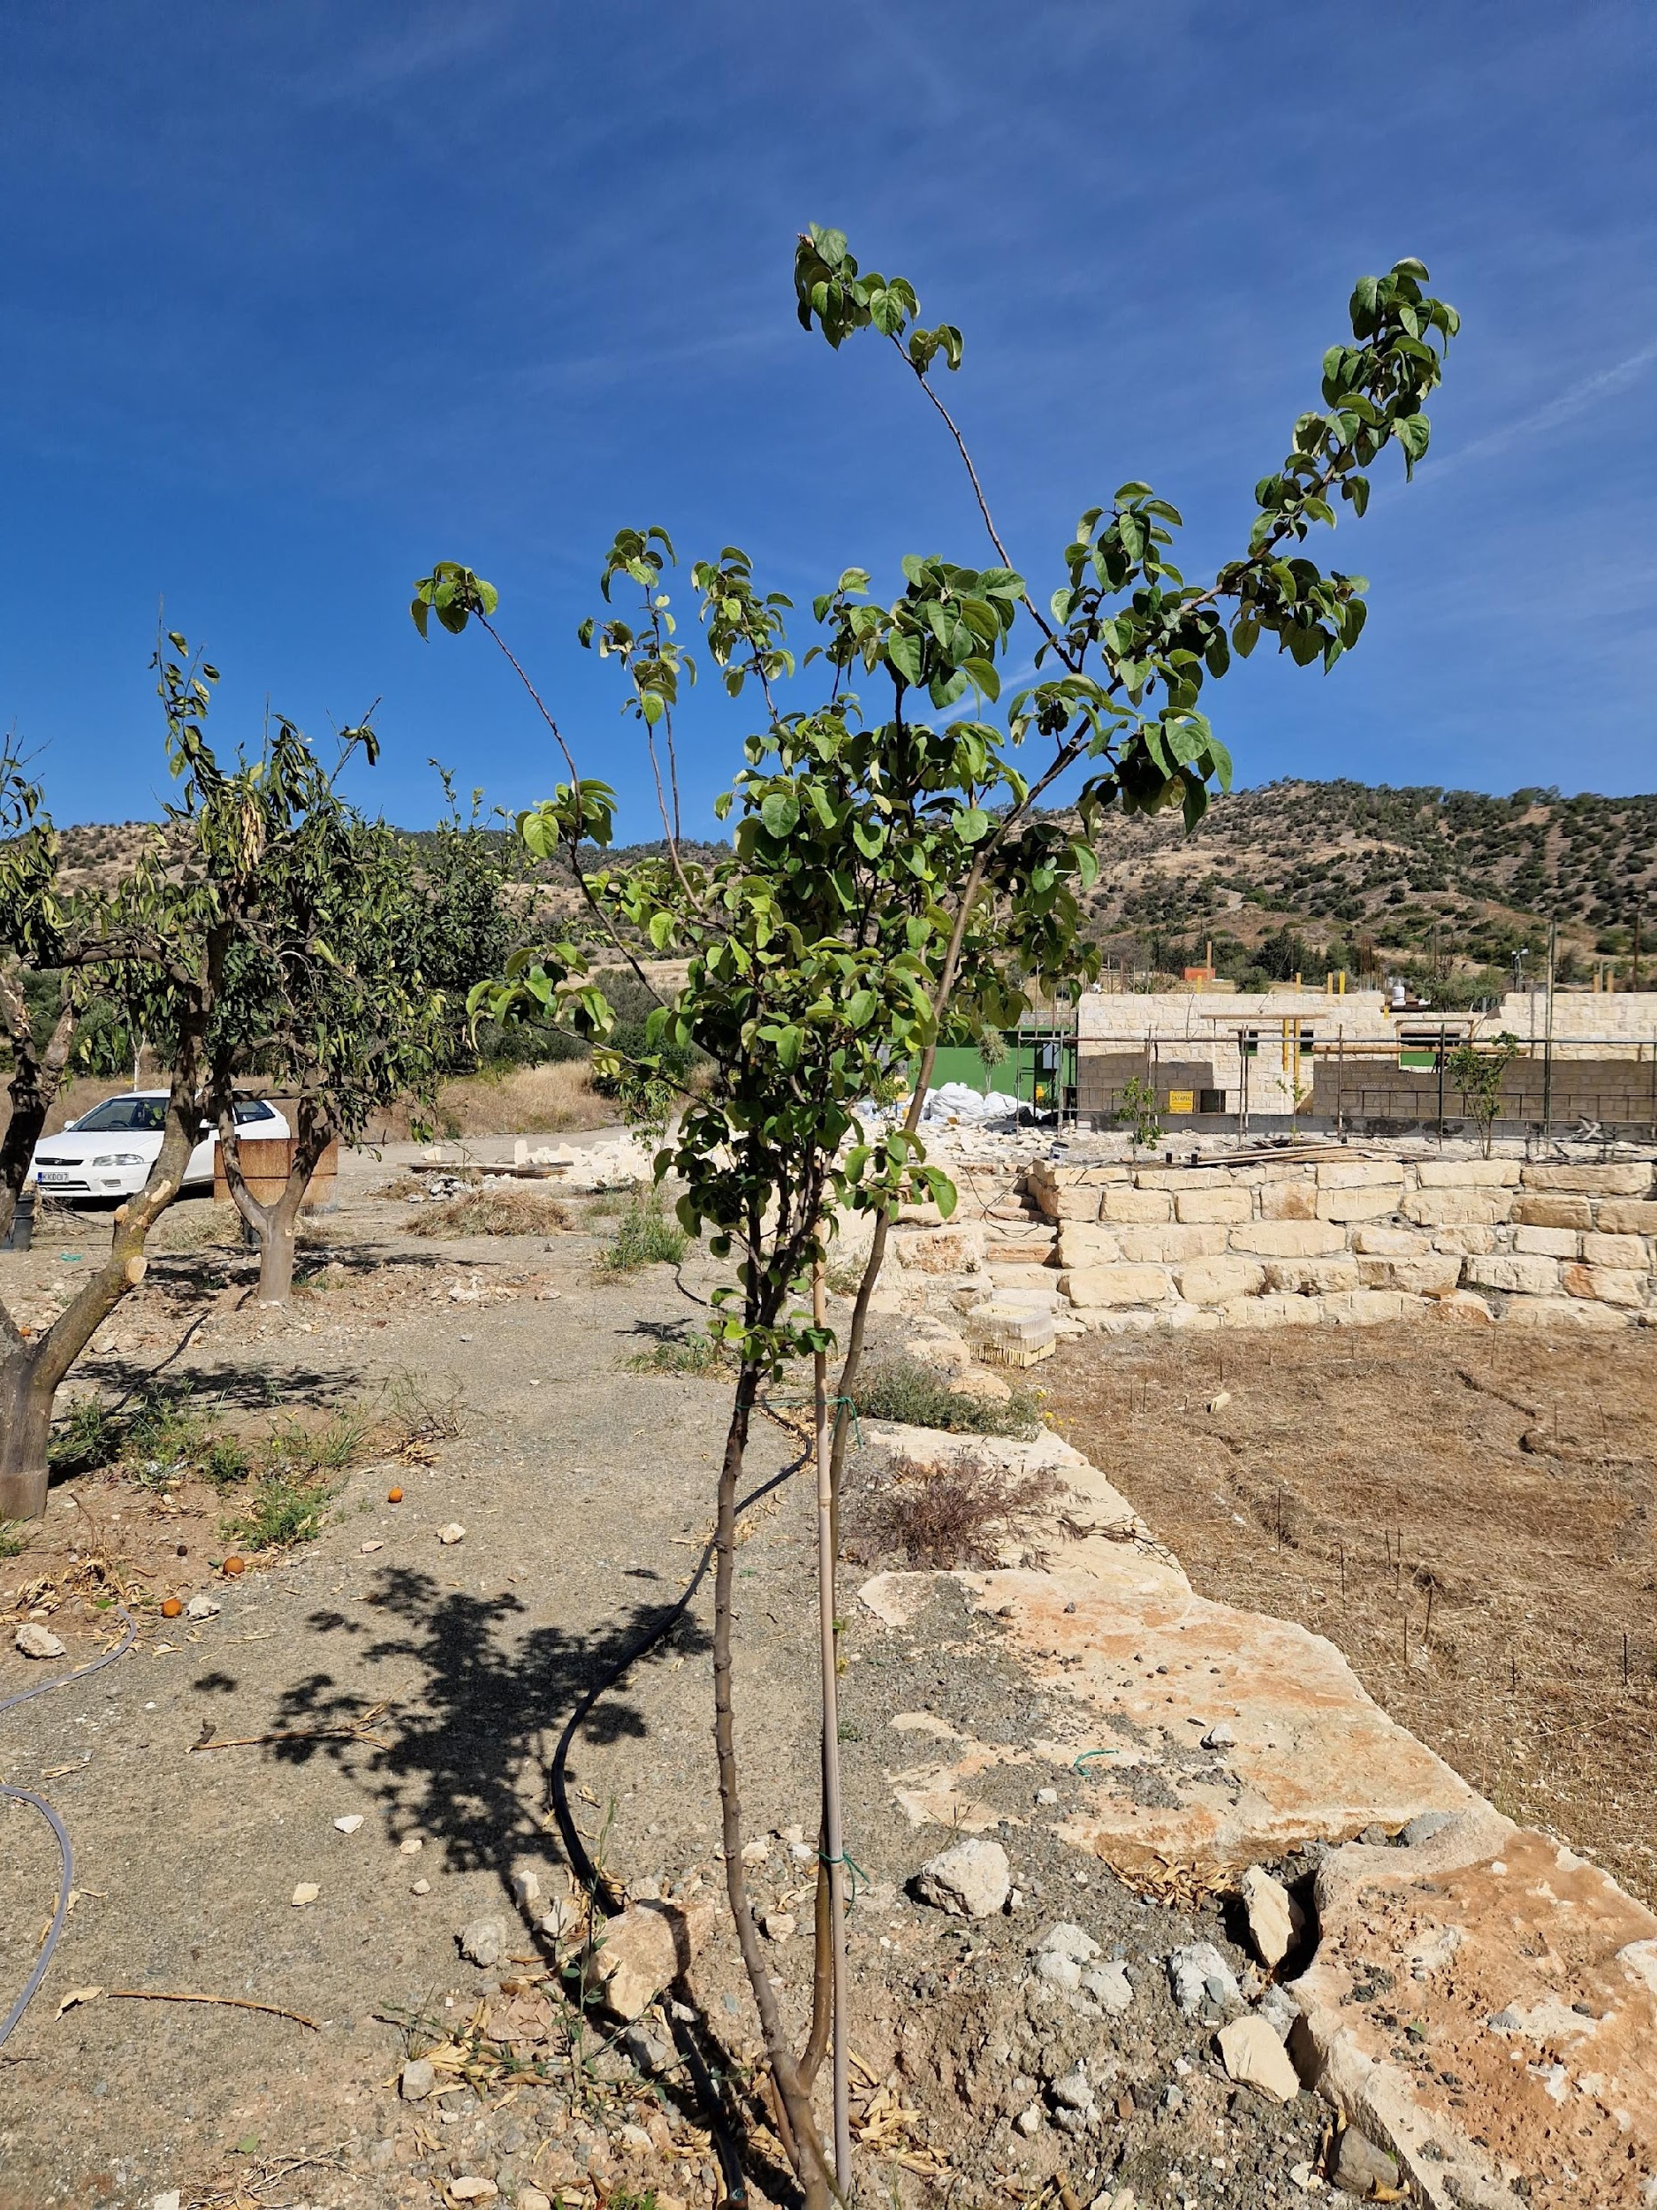
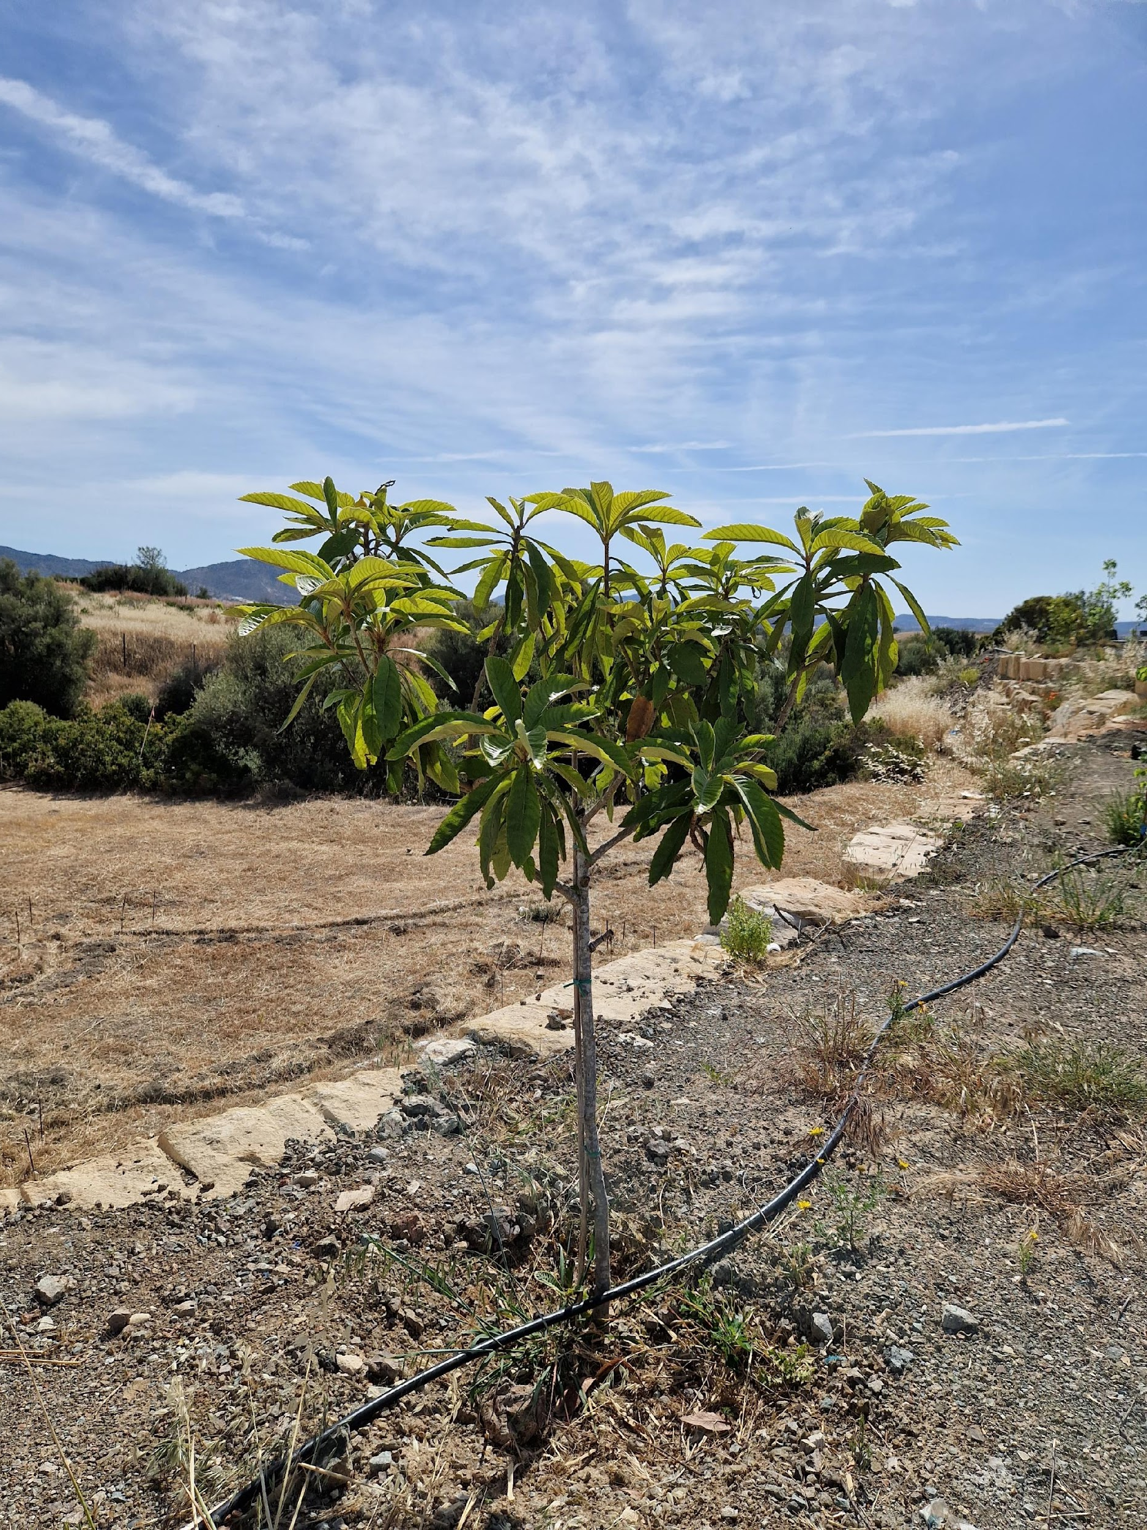
Black mulberries
Pomegranate
White mulberries
Quince
Aronia
Goji
Avocado
Carob
Fig tree
Orange
Chestnut
Olives
Pomelo
Loquat
d

Slide 24
Conclusion
According to our research, almost all types of trees require additional irrigation, both in winter months (December, January and February) and in summer months (June, July, August), apart from chestnut and apricot which requires no additional irrigation during the winter months. Detailed number of irrigation hours with observed irrigation rate is stated in the above chart. Pomegranate, aronia, avocado require the most additional irrigation, while chestnut and apricot the least.
Understandably, taking into consideration the climatic conditions (rainfall) of the Mediterranean area, and Limassol in particular, the plants require more hours of irrigation during the summer months when precipitation is much lower.
It should be taken into account that these data are not accurate enough – there are still some parameters which have not been calculated – transpiration and evaporation of each plant, coefficient of each plant as well as soil permeability (in this case clay). With that data it will be possible to calculate the exact hours of irrigation at this rate of water per hour for each tree type.

Slide 25
Thank you for your attention!
Do you have any questions?

